Slide 1
Anomaly Detection using GAN
By
SUSHRESULAGNA RATH
AI/ML Sr. Engineer
Accenture

Slide 2
Problem Statement:
Time Series Anomaly Detection with Generative Adversarial Networks

Slide 3
What is Time Series Data?
Time series data is a collection of quantities that are assembled over even intervals in time and ordered chronologically.
The time interval at which data is collected is generally referred to as the time series frequency.
e.g: Electricity consumption data, Stock price data

Slide 4
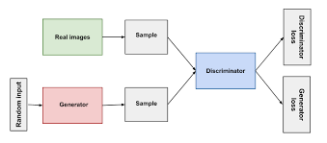
GAN:
Generative modeling is an unsupervised learning task in ML that involves automatically discovering and learning the regularities or patterns in input data in such a way that the model can be used to generate or output new examples that plausibly could have been drawn from the original dataset.
GANs trains the generative model by making it supervised learning problem with 2 sub-models: Generator and Discriminator
Generator – trains to generate new example
Discriminator – tries to classify examples either real or fake

Slide 5
Data Understanding :
Amazon Web Services (AWS) monitoring CPU usage – i.e. average CPU usage across a given cluster. When usage is high, AWS spins up a new machine, and uses fewer machines when usage is low.
The forecasting can be used to minimize the cost by reducing the number of new machine being spun when the usage is low

Slide 6
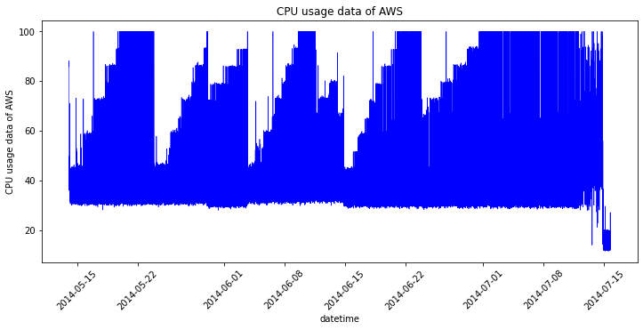
Data Visualization :

Slide 7
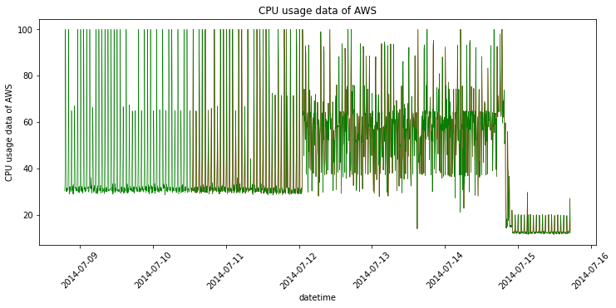
Anomalies Visualization:

Slide 8
Data Preparation:
Steps taken for data preparation:
Reading csv data into a Pandas data frame
Reading annotation data from the respective json file into a dictionary
Scaling the data using Standard Scaler of Sklearn
Batching the data with a fixed window size
Creating labels for the respective samples based on whether it contains anomaly or not

Slide 9
Model Architecture:
LSTM
LSTM 1
LSTM 2
LSTM 3
Dense
Dense
Discriminator
Generator

Slide 10
Model Architecture:
Generator :
-- It consists of 3 LSTM network followed by a dense layer
-- It takes a window of AWS CPU utilization data as input and tries to regenerate it using noise
Discriminator :
-- It consists of 1 LSTM block followed by a dense layer
-- It tries to identify the anomalous windows

Slide 11
Loss Function :
Residual Loss LR:
It measures the point-wise dissimilarity (e.g. values in timestamps) between real sequence and generated sequence.
Discrimination Loss:
The intermediate feature representation of the discriminator is used to estimate discriminator loss.
Anomaly Score:
It is defined as a weighted sum of residual loss and discrimination loss.

Slide 12
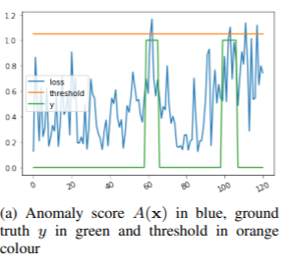
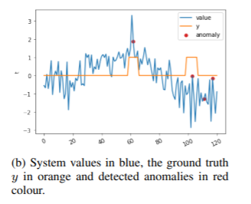
Loss Function :

Slide 13
Results:
True Positive: 3
True Negative: 275
False Positive: 0
False Negative: 22
Accuracy: 0.92
Precision: 1.0
Recall: 0.12
f-measure: 0.21
Auc: 0.56

Slide 14
Conclusion:
Successfully used GAN concept and architecture to model the time series data in order to identify the anomalies in the AWS CPU utilization data.
However, the performance of the model is not acceptable at this point of time as simple architecture has been used.
More robust GAN architectures in combination with attention and bidirectional RNNs can be used to improve performance.
Hyperparameter tuning could also be implemented to improve the model.

Slide 15


